Slide 1
APACHE STRUT 1.x (Cont)

Slide 2
Hello!
Members:
Phạm Hoàng Phước - 18110040
Ngô Minh Thành - 18110045
Đặng Hoàng Sơn - 18110043

Slide 3
Struts Action Form Class
TABLE OF CONTENTS
1
2
Struct Tiles Application
3
Struts Dispatch Action
4
Struts Validator Framework

Slide 4
Struts Action Form Class
1

Slide 5

Definition
An Action Form is a JavaBean that extends org.apache.struts.action.ActionForm.
Action Form maintains the session state for web application and the Action Form object is automatically populated on the server side with data entered from a form on the client side.

Slide 6
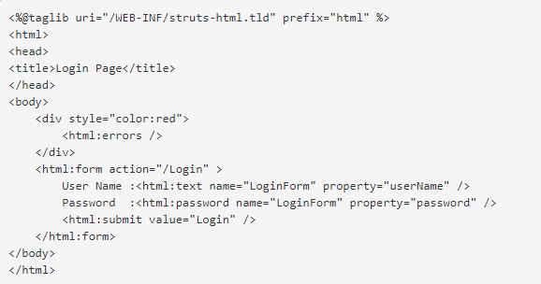

Slide 7
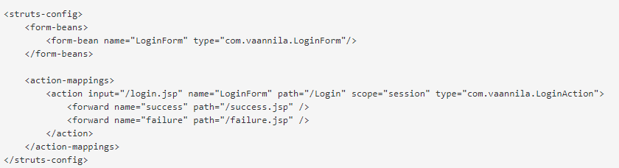

Slide 8
Struct Tiles Application
2

Slide 9
Definition
Tiles is used to create reusable presentation components.
With Tiles, we first define a base layout with different sections after that we define which jsp page should fill in the corresponding regions in an external configuration file.
The same layout can be reused any number of times by specifying different jsp pages.

Slide 10
Steps To Create Tiles Application
Tiles is very useful framework for the development of web applications. Here are the steps necessary for adding Tiles to your Struts application:
1. Add the Tiles Tag Library Descriptor (TLD) file to the web.xml.
2. Create layout JSPs.
3. Develop the web pages using layouts.
4. Repackage, run and test application.

Slide 11
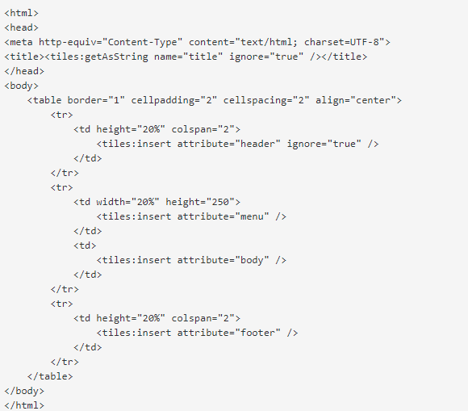

Slide 12
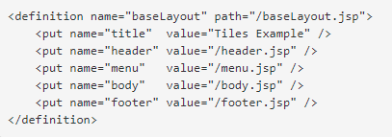

Slide 13
Struts Dispatch Action
3

Slide 14
Definition
Dispatch Action provides a mechanism for grouping a set of related functions into a single action, thus eliminating the need to create separate actions for each functions.
The class User Action extends org.apache.struts.actions.DispatchAction. This class does not provide an implementation of the execute() method as the normal Action class does.

Slide 15
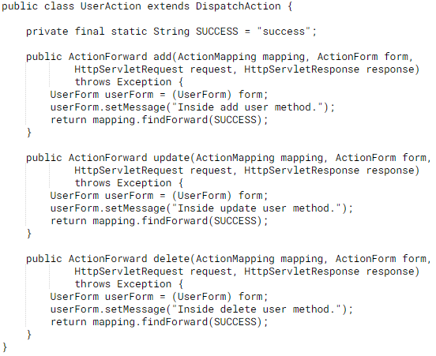

Slide 16
Struts Validator Framework
4

Slide 17
Introduction to Validator Framework
Struts Framework provides the functionality to validate the form data. It can be use to validate the data on the users browser as well as on the server side.
Struts Framework emits the java scripts and it can be used to validate the form data on the client browser.
Server side validation of the form can be accomplished by sub classing your From Bean with DynaValidatorForm class.

Slide 18
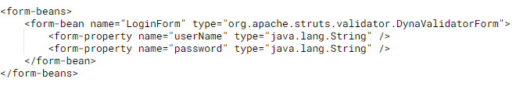
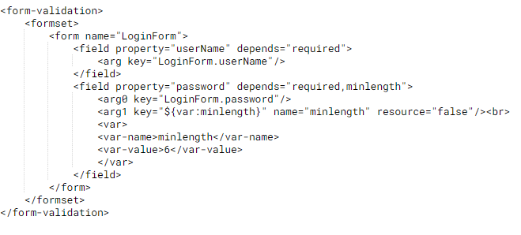

Slide 19
Demo

Slide 20
Thanks!
Any questions?

